Slide 1

School of Computing Science and Engineering
Program: B Tech
Course Code: BCSE3016
Course Name: Web Tech (PBL MODE)

Slide 2
School of Computing Science and Engineering
Project Name: CANTEEN BILLING SYSTEM
Mentor: Rakesh kumar
Batch : 11
Student1 Name : SAJAG CHAUHAN
Student2 Name : MOHD. KASHAF SIDDIQUI
m

Slide 3
School of Computing Science and Engineering Course Code :BCSE3016 Course Name: WEB TECH
Course Outcomes :
Course outcomes (COs)
CO1 | Understand web development strategies and design web pages using HTML, XHTML.
CO2 | Design and enhance static web pages using CSS and XML.
CO3 | Develop a dynamic webpage by the use of java script with its features such as event handling, validation, etc.
CO4 | Write a server side java application called JSP to fetch data sent from client and store it on database.
CO5 | Build Dynamic web site using server side PHP Programming and establish Database connectivity.
Program Name: B-TECH Program Code:

Slide 4
School of Computing Science and Engineering Course Code :BCSE3016 Course Name: WEB TECH
Course Prerequisites
Object Oriented Programming,
Database Management Systems
Program Name: B-TECH Program Code:

Slide 5
School of Computing Science and Engineering Course Code : BCSE3016 Course Name: WEB TECH
Syllabus
Unit I: Introduction to web and HTML 8 lecture hours
Introduction to web, web development strategies, web team. HTML introduction: basic tag, elements, attributes, formatting, comments, marquee, list, table, images, frames, forms; Links : text, image and email. XHTML: Syntax and Semantics.
Unit II: CSS and XML 8 lecture hours
CSS : color, background, fonts, images, link, table, margins, lists, border, paddings, scroll, class.
CSS3 : border Image, round corner, text shadow, layers.
XML: DTD, XML schemes, presenting and using XML.
Unit III: JavaScript 8 lecture hours
Java script: Introduction, documents, forms, statements, functions, objects; Event and event handling; Error handling; validation.
Unit IV: JSP 8 lecture hours
Java server pages (JSP), JSP application design, declaring variables and methods, debugging, sharing data between JSP pages, JSP objects, Session, development of java beans in Jsp, data base action with JSP.
Program Name: B TECH Program Code:

Slide 6
School of Computing Science and Engineering Course Code :BCSE3016 Course Name: WEB TECH
Syllabus cont.
Unit V: PHP 8 lecture hours
PHP (Hypertext Preprocessor): Introduction, syntax, variables, strings, operators, if-else, loop, switch, array, function, form ,mail, file upload, session, error, exception, filter, PHP-ODBC.
Text Books:
T1. Ivan Bayross -Web Enabled Commercial Application Development Using HTML, DHTML, Java Script, Perl, CGI-2000
T2. Uttam/Roy,” WEB Technology”, Oxford Publication.
Reference Books:
R1. Xavier, C, “ Web Technology and Design” , New Age International
R2. Deitel, “Java for programmers”, Pearson Education
R3. Ramesh Bangia, “Internet and Web Design” , New Age International
R4. Jackson, “Web Technologies” Pearson Education
R5. Patel and Barik, ”Introduction to Web Technology & Internet”, Acme Learning
Program Name: B TECH Program Code:

Slide 7

Canteen billing system
BRINGING THE WORLD TO YOUR TABLE

Slide 8
School of Computing Science and Engineering Course Code : BCSE3016 Course Name: WEB TECH
INDEX
Abstract
Introduction
Motivation and Scope
Concept Development
Flowchart
Content Design
Overview
Proposed System
Conclusion
Program Name: B TECH Program Code:

Slide 9
School of Computing Science and Engineering Course Code :BCSE3016 Course Name: WEB TECH
ABSTRACT
The project "CANTEEN BILLING SYSTEM" enables the end users to register online and also an OTP on main registration system is provided for visitors and temporary customers .Users are able to read and select food from e-menu and order food online by just selecting the food that the user want to have using the website or application .The result after ordering the food from the menu card option will directly appear on the portal of the Admin//Owner and also the chef ,who is going to cook the food for you.
Program Name: B-TECH Program Code:

Slide 10
School of Computing Science and Engineering Course Code :BCSE3016 Course Name: WEB TECH
INTRODUCTION
Canteen Billing System is the system where customers order their food and receive food without any delay as they directly go and collect what they ordered without waiting for a turn or waiting time .
The System aims to accelerate customer orders and customer order system used by employees to accept customer order.
Program Name: B-TECH Program Code:

Slide 11
School of Computing Science and Engineering Course Code :BCSE3016 Course Name: WEB TECH
MOTIVATION AND SCOPE
Reservation System
Easy way to enter new Customers
Provide Membership to Customers
Provide Many Payment mode
Automatic GST calculation
Program Name: B-TECH Program Code:

Slide 12
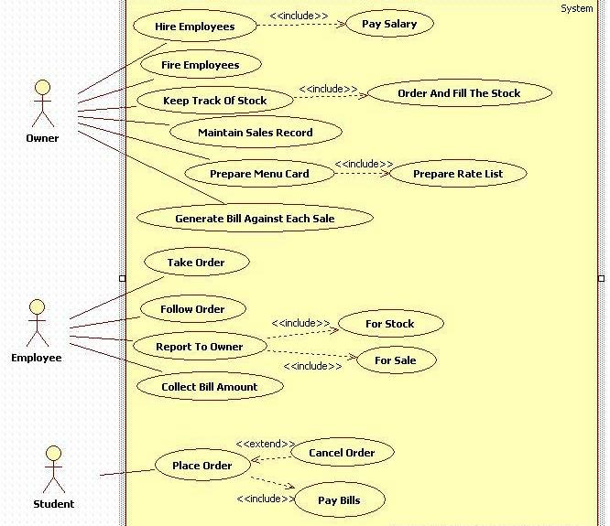
School of Computing Science and Engineering Course Code :BCSE3016 Course Name: WEB TECH
CONCEPT DEVELOPMENT
Program Name: B-TECH Program Code:

Slide 13
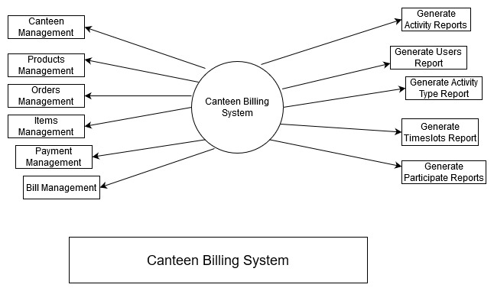
FLOWCHART

Slide 14
School of Computing Science and Engineering Course Code :BCSE3016 Course Name: WEB TECH
CONTENT DESIGN
We used HTML for the webpage creation.
We used CSS for layouts and fonts.
We used JavaScript for dynamic content.
Google Map is placed in the contact page to access the address of our trust.
Simple and user friendly design for easy access.
Program Name: B-TECH Program Code:

Slide 15
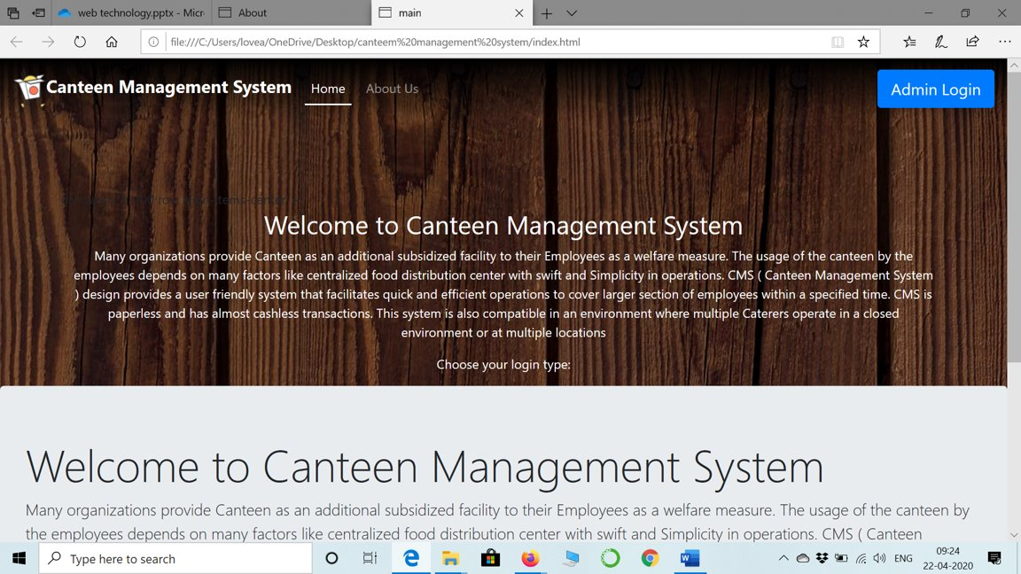
OVERVIEW

Slide 16
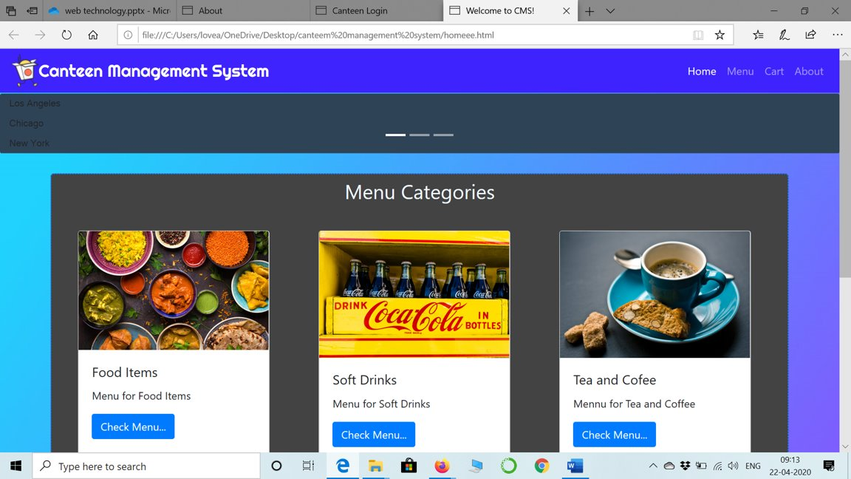

Slide 17
School of Computing Science and Engineering Course Code :BCSE3016 Course Name: WEB TECH
PROPOSED SYSTEM
Easy and secure payment options with industry-leading, online banking standard technology.
Secure and transparent escrow accounting.
Program Name: B-TECH Program Code:

Slide 18
School of Computing Science and Engineering Course Code :BCSE3016 Course Name: WEB TECH
CONCLUSION
The outcomes of all the hard work is here .We have a system ,which takes the necessary choice of customers according to the filter like category of the food .This is achieved through an easy to use graphical interface menu options.The user can add any number of items to the cart from any of the available food Categories.
Customer pay the bill via cash ,debit card or credit card an sometimes using online transaction processes.
Here, the system works in perfect way.
Program Name: B-TECH Program Code:

Slide 19


